Slide 1

Toronto Fire Incidents:
Monetary Losses Prediction using Regression Models
ITEC 4305: Final Presentation
Ryan Liyanage, 216963654
Derek Anthony Hau Kau Fong, 218387209
Maurílio Tiago Brüning Schmitt, 220052197

Slide 2
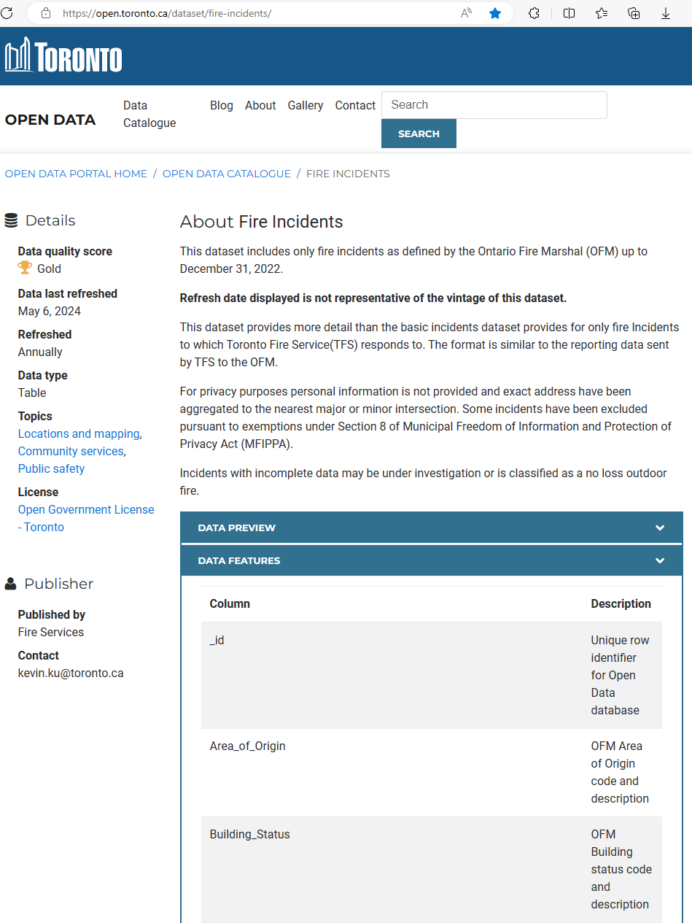
Recap: Dataset
The dataset includes fire incidents as defined by the Ontario Fire Marshal (OFM) up to December 31, 2022.
It contains 43 columns and nearly 30k rows.
https://open.toronto.ca/dataset/fire-incidents/

Slide 3
Recap: Objectives
Estimate dollar loss of fire incidents, using open fire incident data from the city of Toronto.
Analyze factors including, but not limited to:
The extent of fire, source of fire, ignition material and property use, control time, response time.
Aim to provide an accurate estimation of the amount of dollar loss per fire incident.
Can offer recommendations to reduce the severity of fire incident impact to fire marshals.

Slide 4
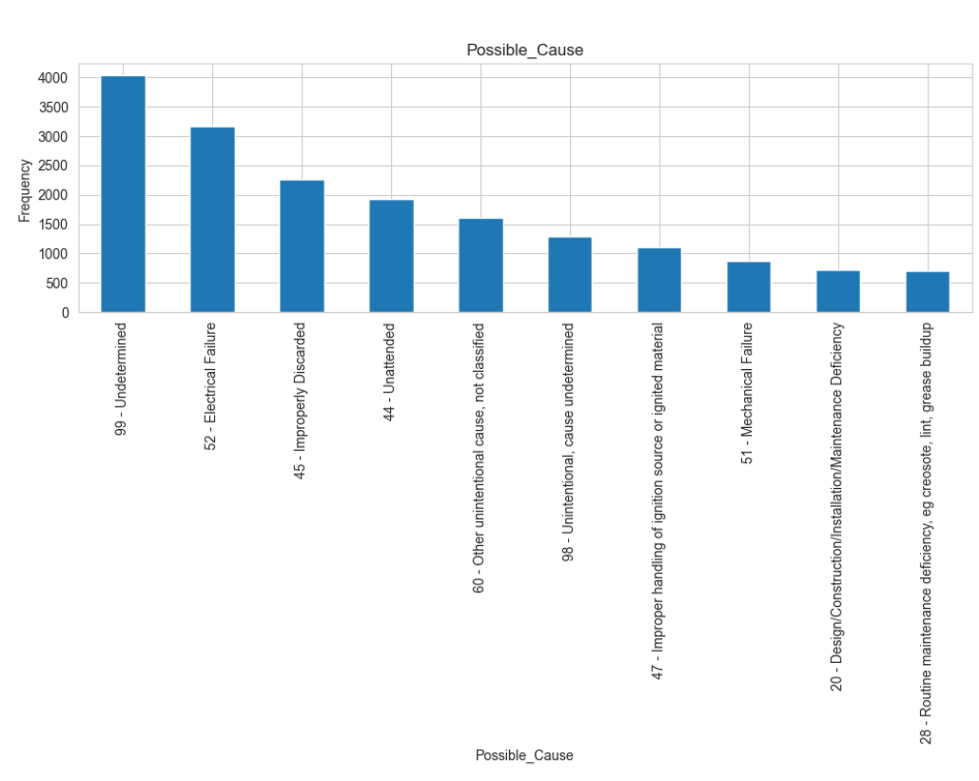
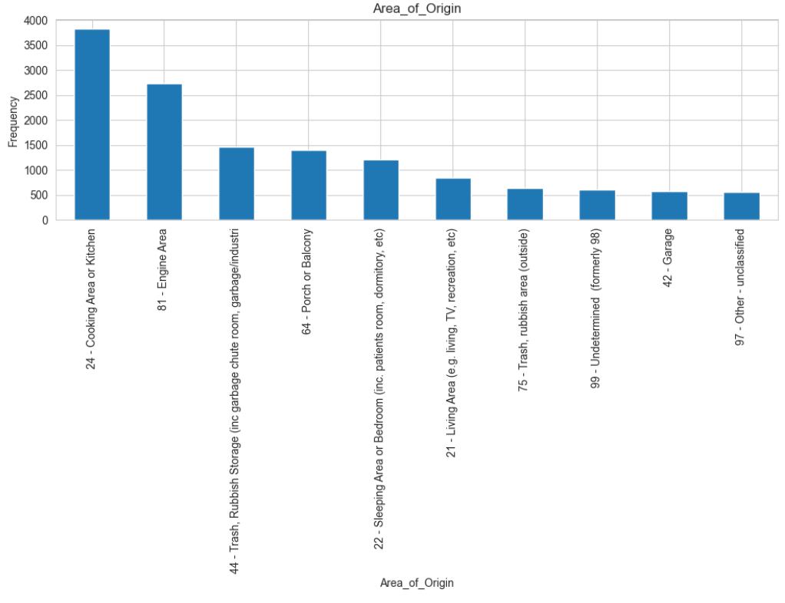
Recap of Findings from Data Analysis & Exploration
Area of origin for fire incidents.
Probable cause of fire incidents.

Slide 5
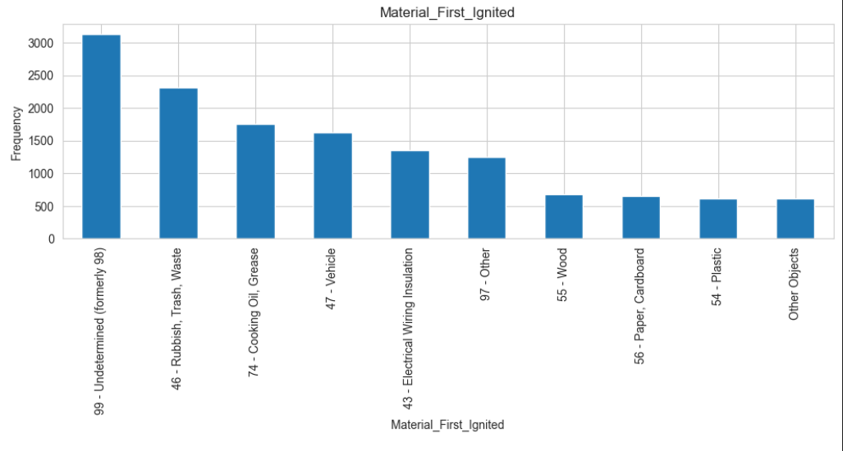
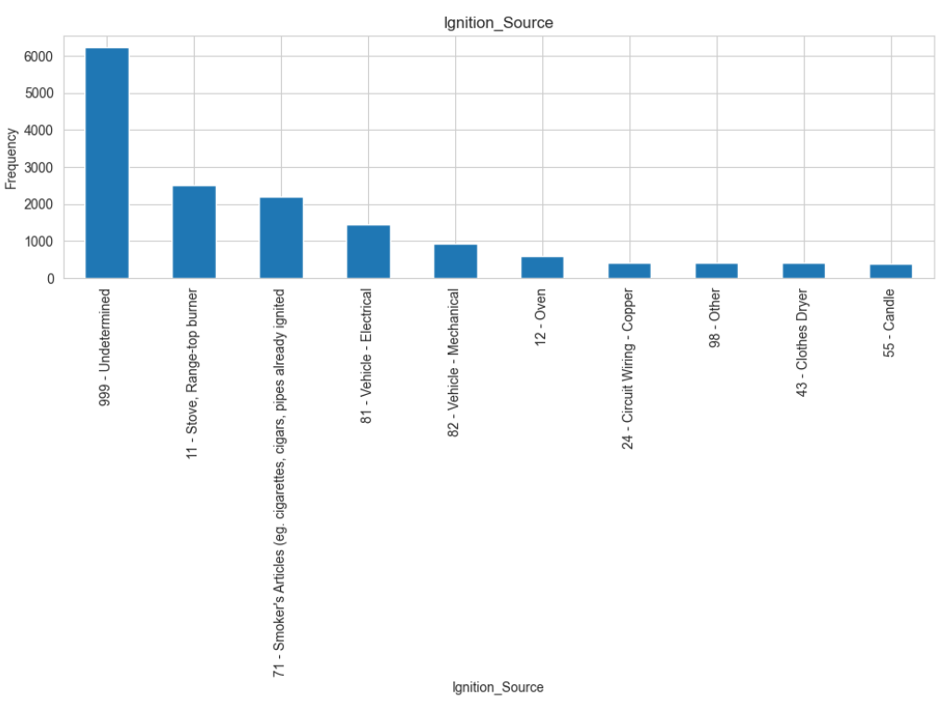
Material first ignited for fire incidents.
Ignition Source of fire incidents.

Slide 6
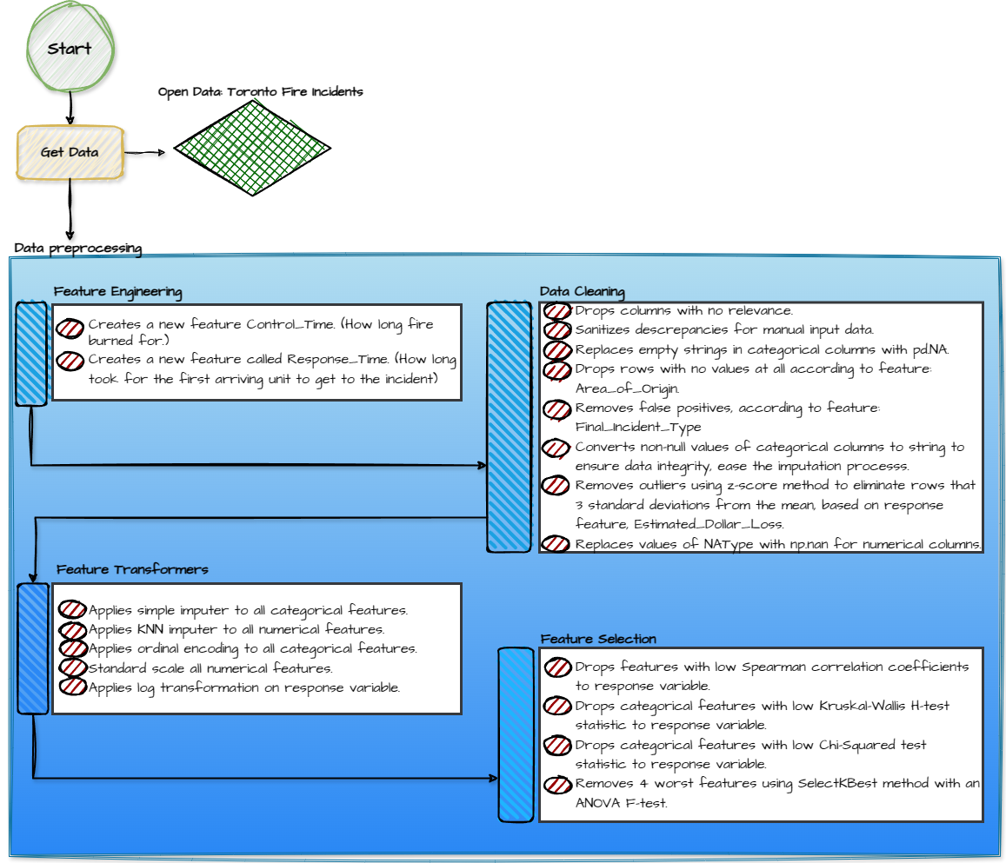
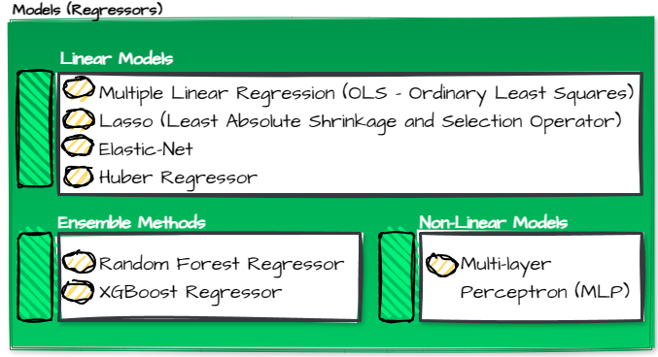
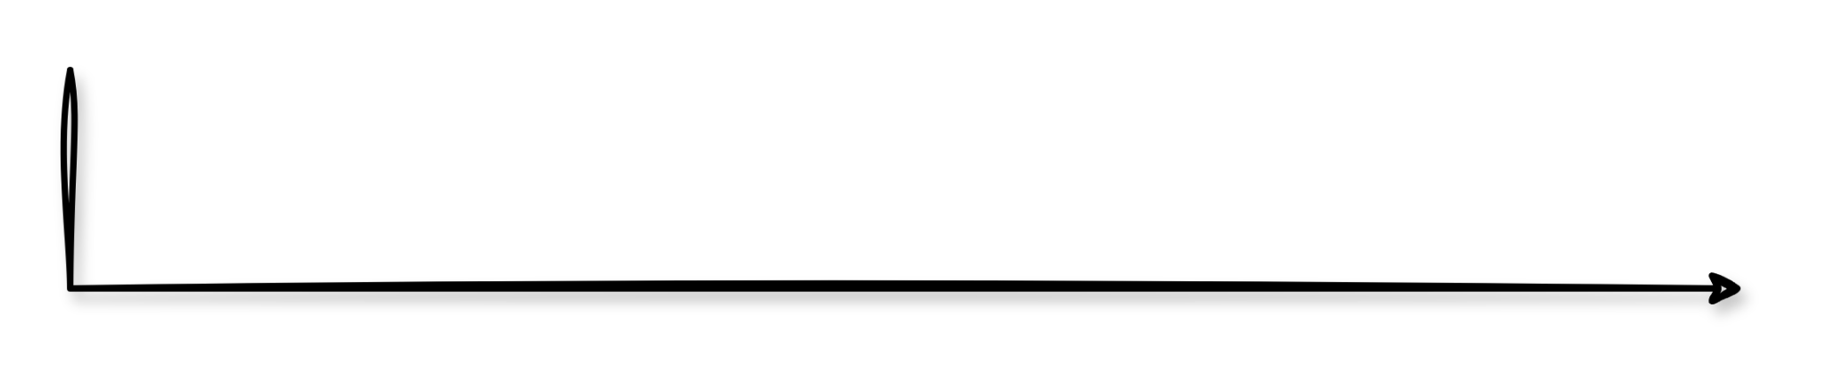
Modeling Pipeline

Slide 7
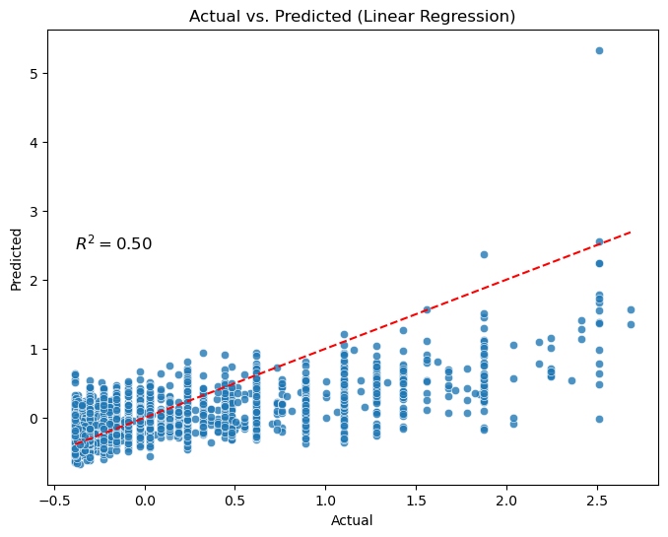
Model: Multiple Linear Regression
R-squared score: 0.5005
Mean Absolute Error: 0.1885541610880164
Mean Squared Error: 0.09082654811349446

Slide 8

Model: Lasso (L1 Regularization)
Best parameters using GridSearchCV:
{'alpha': 0.01}
R-squared score: 0.4902
Mean Absolute Error: 0.1870998903408478
Mean Squared Error: 0.09271636404302167

Slide 9

Model: ElasticNet
Best parameters using GridSearchCV:
{'alpha': 0.1, 'l1_ratio': 0.1}
R-squared score: 0.4860
Mean Absolute Error: 0.18796568279373058
Mean Squared Error: 0.093463413322066

Slide 10
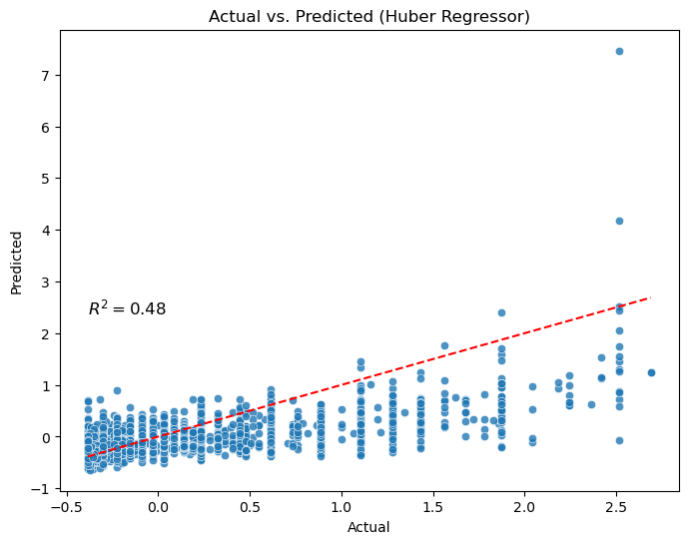
Model: Huber Regressor (Robust regressor)
Best parameters using GridSearchCV:
{'alpha': 0.0001, 'epsilon': 2.0, 'max_iter': 1000, 'warm_start': True}
Best cross-validation score: 0.42
R-squared score: 0.4845
Mean Absolute Error: 0.17671432508880264
Mean Squared Error: 0.09375232865828498

Slide 11
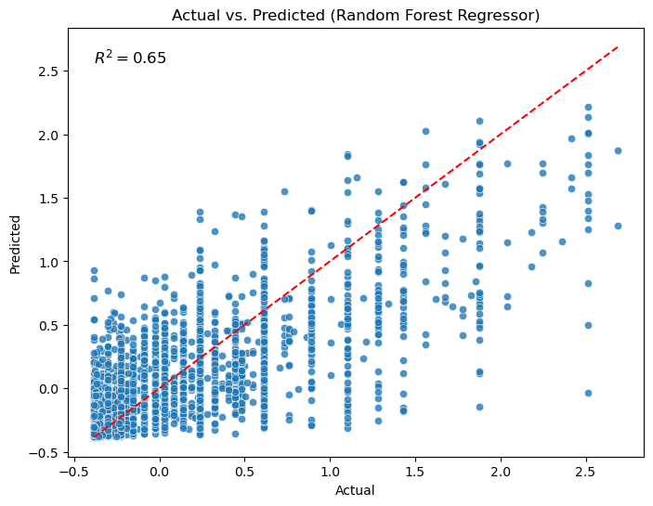
Model: Random Forest Regressor (Ensemble method)
Best parameters using GridSearchCV: {'max_depth': 30, 'min_samples_leaf': 4, 'min_samples_split': 10, 'n_estimators': 300}
Best cross-validation score: 0.62
R-squared score: 0.6498
Mean Absolute Error: 0.13908100480770472
Mean Squared Error: 0.0636864290950335

Slide 12
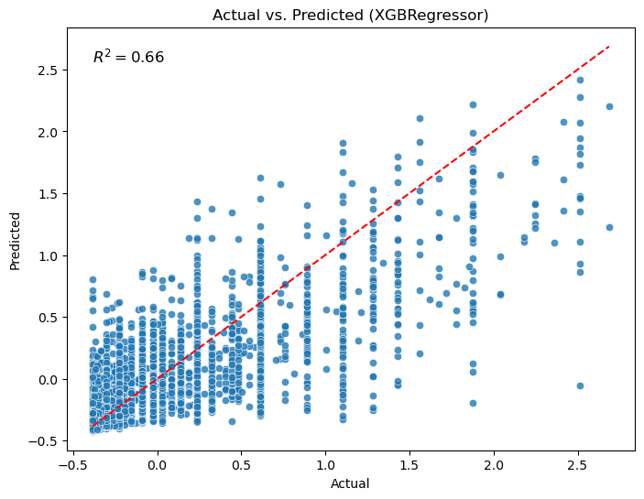
Model: XGBRegressor (Ensemble method)
Best parameters using GridSearchCV:
{'gamma': 0.1, 'learning_rate': 0.05, 'max_depth': 4, 'n_estimators': 200}
Best cross-validation score: 0.63
R-squared score: 0.6583
Mean Absolute Error: 0.13951366645057664
Mean Squared Error: 0.06213834505077028

Slide 13
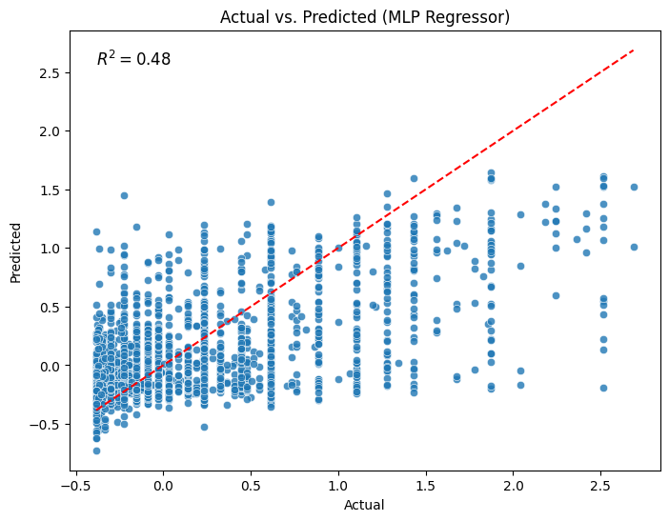
Model: MLP Regressor (Non-Linear Model)
Best parameters using GridSearchCV: {'activation': 'tanh', 'alpha': 0.01, 'batch_size': 32, 'early_stopping': True, 'hidden_layer_sizes': (100, 50), 'learning_rate_init': 0.005, 'n_iter_no_change': 10, 'validation_fraction': 0.1}
Best cross-validation score: 0.42
R-squared score: 0.4751
Mean Absolute Error: 0.20134687709558402
Mean Squared Error: 0.0954568126536821

Slide 14
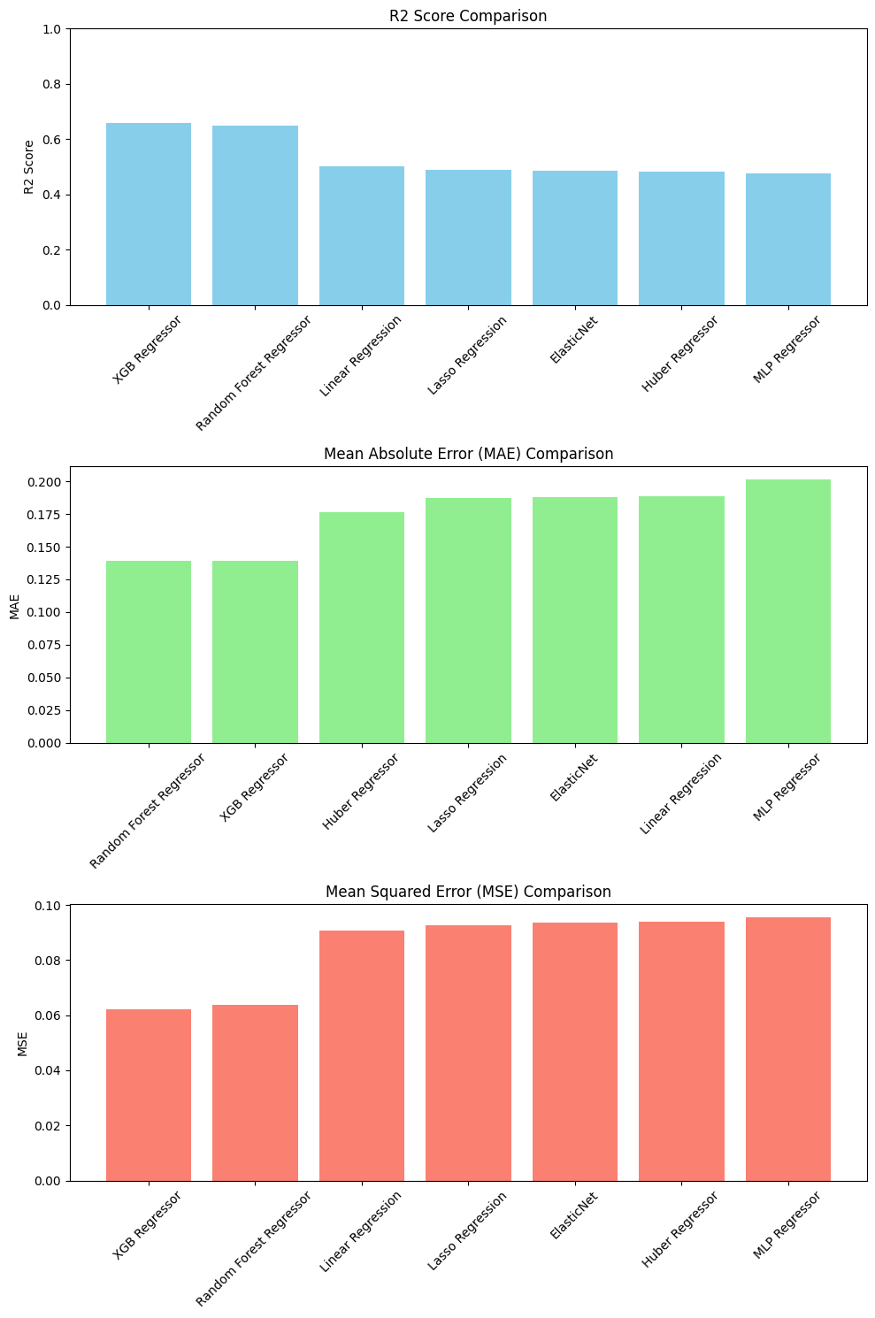
Model Evaluation Comparison

Slide 15
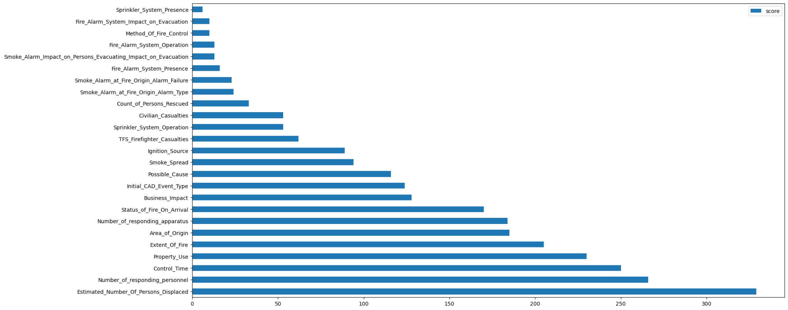
Results: the winner XGBRegressor
Our best model was able to explain 66% of variance. The most important features were:

Slide 16
Results: Top 5 most important features XGBRegressor
5)
4)
3)
2)
1)
In the article we used as reference, the authors say that the top 3 strongest effects on the fire losses are:
Degree of fire severity
Dispatched fire-fighting forces
Fire control time.
Our model matches the article.
[Y.-S. Lin, C.-H. Lin, P.-C. Huang
Construction of explanatory fire-loss model for buildings
Fire Safety Journal, 44 (8) (2009), pp. 1046-1052, 10.1016/j.firesaf.2009.07.005]

Slide 17
Conclusion and Insights
Final model that was chosen: The XGB Regressor.
Based on the top features and our chosen model:
The City of Toronto can improve their risk management plans.
More informed decisions with important features in mind.
The City of Toronto can more effectively allocate their resources.
Mitigate financial losses
Mitigate casualties
Ultimately, improving Toronto’s quality of life.

Slide 18
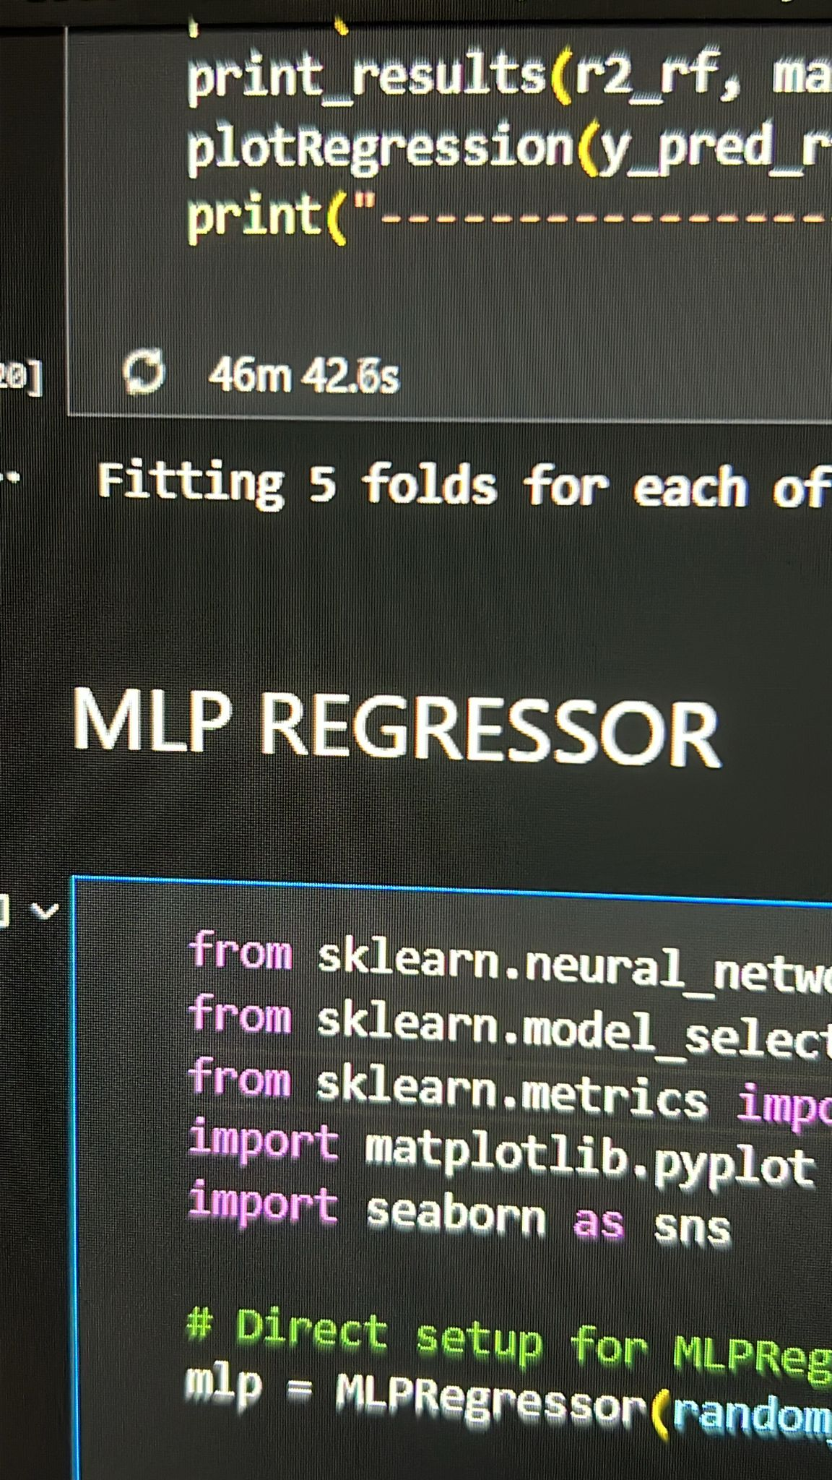
Challenges
Pipeline (sklearn.pipeline.Pipeline)
Finding the best parameters using GridSearchCV in models such as Huber Regressor, Random Forest Regressor, XGBRegressor took some time.
Resolving git merge conflicts for .ipynb files, which were read in JSON format.

